Slide 1
New Hanover Township
2021 Budget Presentation

Slide 2
What’s a budget?
Notes:
A budget is an estimation of revenue and expenditures over an annual basis and should be reviewed throughout the year.
It’s a planning tool for success. You need one!

Slide 3





Slide 4
What’s in the budget?
Letter of Transmittal (Budget Message)
Fund Budgets
Supporting Data (Budget Schedules)
These documents are located on our website at
www.newhanover-pa.org.
Notes:
The Letter of Transmittal is an overview of the budget in commentary form and provides a narrative review of significant trends and factors affecting the proposed budget and highlights areas of importance in the financial section. It also contains a summary of program and service delivery, cash position, and revenue and expense projections.
The proposed 2021 Budget consists of 13 funds detailing the projected revenues and proposed expenditures for the coming year in line item format. A three-year history of actual (audited) revenues and expenditures and year-end estimates for the current year indicate trends and beginning and ending fund balances show cash position.
The Supporting Data (Budget Schedules) offer an additional level of detail for specific line items in each operating budget.

Slide 5

Budget Highlights
The proposed budget maintains current tax rates.
There are no new staff positions in the proposed budget.
The proposed budget maintains municipal services at current levels.
Capital appropriations maintain infrastructure and equipment.

Slide 6





The proposed budget maintains current tax rates.
Notes:
We have 4 tax levy’s – General Fund (0.957), Fire Protection Fund (0.310), Road Equipment Capital Fund (0.180) and Recreation Fund (0.140). This will be the 15th year in a row that taxes have not been increased; we reduced them by 5% in 2019.

Slide 7

LOCAL TAX MILLAGE COMPARISON
Notes:
USE PEN -- Township @ 5% -- County at 12% and School District at 83% -- At the current tax levy of 1.587 mills, real estate taxes for a home assessed at the average assessment value of $152,334 would pay $242 per year or about $20 per month for Township services.

Slide 8
There are no new staff positions in the proposed budget.
Department | Current | Replacement | Proposed New
Executive | 1 | 0 | 0
Finance Department | 1 | 0 | 0
General Administration | 2 | 0 | 0
Police Department | 13 | 0 | 0
Code Enforcement and Zoning | 2 | 0 | 0
Public Works Department | 7 | 1 | 0
Parks and Recreation Department | 0 | 1 | 0
Municipal Authority (Sewer) | 5 | 0 | 0
 | 31 | 2 | 0
Notes:
At full staffing levels, we have 33 employees: 32 FTE and 1 PTE. In 2021 we will have 31 FTE and 2 PTE (Police Officer and Public Works Laborer) with 9 lifeguards as seasonal employees.

Slide 9
Budget Overview

Slide 10
Notes:
USE PEN - There are 13 Funds in the proposed budget (1 Governmental Fund, 4 Special Revenue Funds, 3 Capital Project Funds, 2 Enterprise Funds, and 2 Trust Funds). The Government Finance Officers Association (GFOA) recommends a municipality to have between 8% and 12% in fund balance reserves. At the end of 2021, the General Fund will have approximately 57% in fund balance reserves.

Slide 11
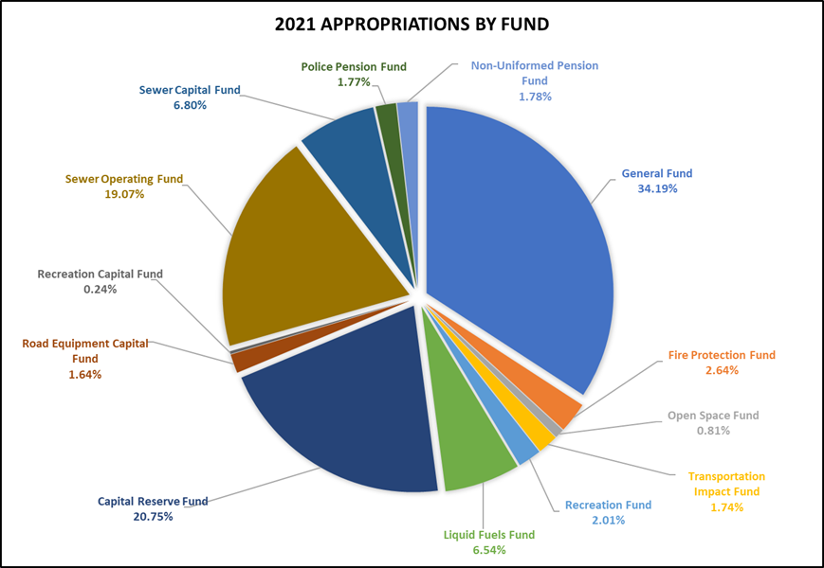
Notes:
The General Fund is the largest Operating Fund and accounts for many common local government services, including police protection; planning and zoning; general administration; finances; legal and engineering services; tax collection services; and public works services and maintenance.
General Fund appropriations total $4.10 million. Appropriations in the Special Revenue Funds include the Fire Protection Fund ($317,250), Open Space Fund ($97,250), Transportation Impact Fund ($209,150), Recreation Fund ($245,575) and Liquid Fuels Fund ($785,000). Appropriations for the Sewer Operating Fund total $2.28 million. Combined capital appropriations total $3.53 million and pension funds total $426,000.

Slide 12
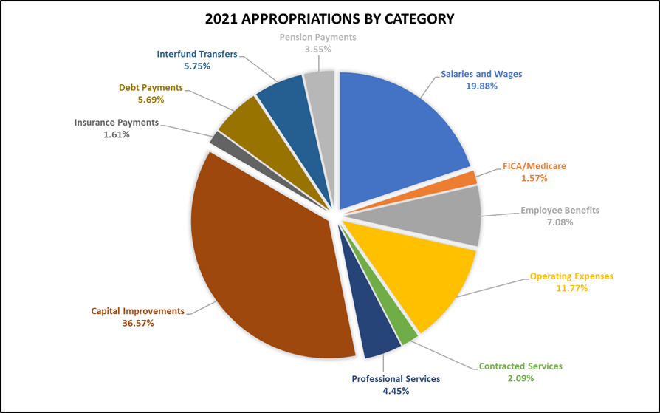
Notes:
The General Fund, in combination with the Sewer Operating Fund and Recreation Fund, account for all personnel, fringe benefit, insurance, routine maintenance and operational expenditures. Personnel costs remain the largest single expense in the operating budgets representing 28.5% of total appropriations. Operating expenses, contracted services, professional services, and insurance account for an additional 20% of budgeted expenditures. These percentages usually combine to be the highest expenses in local governments as public service agencies and demonstrate that significant cost cutting can only occur with staff reductions that directly affect service delivery.

Slide 13
Budget Highlights
Notes:
Revenue then expenses for GF

Slide 14
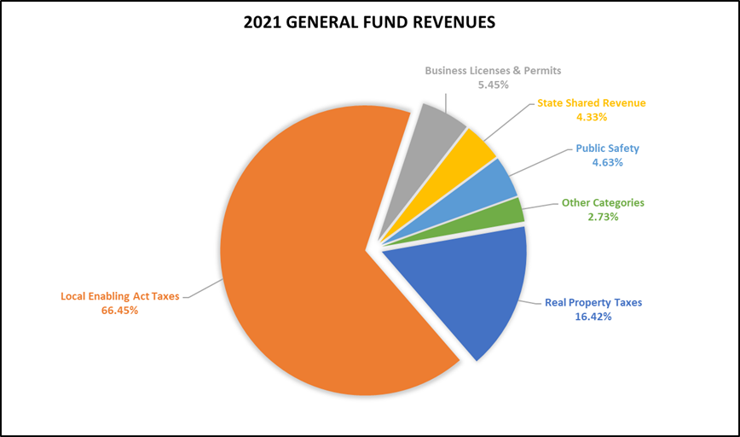
Notes:
The primary revenue sources for the General Fund are real estate taxes, Act 511 taxes (earned income, per capita, local services, and transfer taxes), business licenses, permit fees, grants, state-shared entitlements, and charges for service. Let’s see some examples.

Slide 15
Notes:
Local enabling taxes account for almost 2/3rds of our revenue. The Township levies a 1% earned income tax and revenue generated from residents is shared equally with the Boyertown School District. Earned income taxes will generate a projected $2.39 million in 2021, representing 54% of total revenues in the General Fund. Real estate taxes are projected to come in close to $722,000, representing about 16.4% of total revenue in the General Fund.

Slide 16
Notes:
Transfer taxes are a tax on real estate sales within the Township. The tax rate is 2% of the sale price. County government receives 1% of the tax proceeds, and the Boyertown School District and Township share the remaining 1% equally. Transfer tax receipts have steadily increased throughout the past several years as the real estate market is strong and development continues in the Township. Current projections indicate transfer tax receipts in 2021 will reach approximately $488,000, but this may be higher given increased development activity.
An estimated 422 properties will transfer ownership in 2021, which is projected to be slightly less than data in 2019 and 2020. Both of those data sets were based on citizens taking advantage of historically low mortgage rates, and the trend may continue into 2021. There has been an average of 8% of the existing parcel stock (422 properties) transferred over the previous three years. Construction activity enhances transfer tax revenue and new construction will increase assessed value and real estate tax revenue and minimizes the need for future real estate tax increases.

Slide 17
Notes:
Revenue from permit fees has remained steady since 2014 and will continue to be a major income stream in 2021 as approved developments continue to develop new residential units. Permit fee revenue in 2021 is estimated at $203,000. The Township has averaged about 60 to 100 permits for new homes since 2016 and projects to have around 80 permits in 2021, producing $123,500, or 61% of total permit fee revenue. This revenue source will decrease when development ceases, but the effects will be offset by the subsequent increase in real estate and earned income tax revenue. Note that this will be the last year we have significant development in the Township until further development is approved.

Slide 19
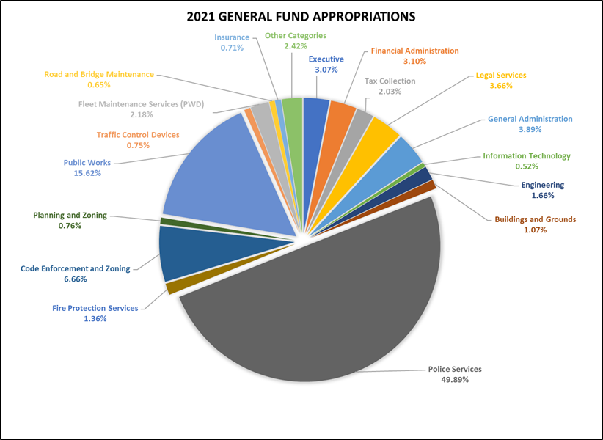
Notes:
Proposed General Fund appropriations in 2021 total $3.83 million before interfund transfers. This represents a minor decrease ($27,000) over the 2020 Budget. Not seeing an increase in expenditures is atypical, but this will be attributed to staffing changes and resource allocation with the Municipal Authority, the removal of a staff position with the Public Works Department, and the reduction in needed legal services seen throughout the recent budget cycles. Each year does include increases in certain line items, specifically to wages (uniformed employees are receiving a place holder 3.0% increase, but the actual amount will be determined by contract negotiations, and non-uniformed employees a 3% increase) and benefits (healthcare costs increased 2.50%).
Appropriations also include expenses that may not be realized or surpassed for legal issues ($100,000 for issues related to Gibraltar Rock and $50,000 to complete a new contract with the Police Department) and healthcare ($488,000 because we budget for utilization at 70%, the industry standard). There is also an appropriation for an interfund transfers to the Capital Reserve Fund ($2,000,000) to support initial costs and to offset a potential bank loan or bond issue for capital improvements based on the Capital Improvement Plan.

Slide 20
Notes:
The General Fund, in combination with the Sewer Operating Fund and Recreation Fund, account for all personnel, fringe benefit, insurance, routine maintenance and operational expenditures.
Personnel costs remain the largest single expense in the operating budgets representing 28.5% of total appropriations.

Slide 21
General Fund
Key Revenues
Key Expenditures
$714,000 in Real Estate Taxes
$2,922,000 in Local Tax Enabling Act Taxes
$443,000 in Licenses and Permits
$190,000 in State Shared Revenue
Personnel
$140,000 in Legal Services
$63,000 in Engineering
$275,000 Interfund Transfer to CRF
2021 Estimated Net Fund Balance - $2,192,000
Notes:
Government Finance Officers Association (GFOA) recommends a municipality to have between 8% and 12% in fund balance reserves. At the end of 2020, the General Fund will have approximately 57% in fund balance reserves.

Slide 22
Fire Protection Fund
Key Revenues
Key Expenditures
$234,000 in Real Estate Taxes
$78,000 in Foreign Fire Insurance Tax
$215,000 VFC Contribution
$78,000 in Foreign Fire Insurance Tax
2021 Estimated Net Fund Balance - $22,000
Notes:
The Township levies a .310-mill real estate tax dedicated to fire protection services that will generate approximately $231,500 in 2021. The maximum allowable tax levy is three mills. The Fire Company also receives a variable amount annually from state-shared revenue tax paid by foreign fire insurers and used for relief or pension funds for paid or volunteer employees of fire departments. The Fire Company places a minimum of 30% of total revenue received into a capital improvement fund for apparatus purchases.
The company has 56 active members that train each week and volunteer their time to support the community. Seventy-Five percent (75%) of the fire personnel have attained the nationally recognized Firefighter 1 Pro Board certification with Fifty percent (50%) of those members attaining the Firefighter 2 Pro Board certification as well as state rescue practices, which exceeds 200 hours of formal firefighter training. All personnel continue to attain the federally mandated Hazardous Materials Operations training. Also, the Fire Company has 19 support staff personnel for administrative functions and a Cadet/Junior Firefighting Program, which currently includes 11 individuals between 14 and 17 years old being mentored to begin volunteer firefighting when each member turns 18 years old.

Slide 23
Open Space Fund
Key Revenues
Key Expenditures
$693,000 in Earned Income Tax
$77,000 in Debt Obligations
2021 Estimated Net Fund Balance - $2,108,000
Notes:
The Township levies a .15% earned income tax that will generate approximately $693,500 in 2021. The earned income tax was first concepted in 2006 through resolution to “provide for the conservation of open space to control growth and development” and then later passed through referendum to “finance the purchase of open space and development rights.”
The Township currently has 1,599 acres of permanently preserved farmland (18 parcels through the County and 1 parcel through the Township) and 1,855 acres of agricultural security area land (57 parcels total), which defers taxes for undeveloped agricultural land.

Slide 24
Notes:
Our debt will be satisfied in May 2021.

Slide 25
Sewer Operating Fund
Key Revenues
Key Expenditures
$2.08 million in EDU Rental Billings
Personnel
$147,000 in Utilities
debt obligations
$375,000 Interfund Transfer to SCF
2021 Estimated Net Fund Balance - $1,359,000
Notes:
The Sewer Operating Fund is an enterprise fund, a government-owned fund that sells services to residents in the Township and functions under a lease agreement between the Township and the New Hanover Township Municipal Authority to handle the day to day operations of the plan. The Municipal Board has the right to set sewer rates, but the Board of Supervisors has the right to pass the Authority’s budget. The Township Manager is responsible for overseeing employees at the Authority.

Slide 26
Notes:
The 1998 loans ends in 2026 and the 2020 loan in 2030. There is a prepayment penalty on the 98 and 20 loan through 2025

Slide 27
Sewer Capital Fund
fixing the blacktop at the treatment plan
set aside funds for sewer main repairs and replacements, as needed
an overhead workstation crane system for maintenance and equipment failures to the pumps and grinders
a fire alarm panel upgrade; upgrades to our three digester blower motors
a flow meter for the Acorn Hills Pump Station
replacements for the slide gates that regulate flow going to the oxidation ditches
a replacement digester yard valve
spare digester mixer
2021 Estimated Net Fund Balance - $1,421,000
Notes:
AROUND $800K IN EXPENSES

Slide 28

Transportation Impact Fund
completion of traffic engineering and design services for improvements at the southern intersection of North Charlotte Street and Moyer Road
traffic engineering and design services to install an additional video camera to the existing video detection system for the Renninger Road approach to upgrade the last remaining inductive loop at the intersection of Big Road and Hoffmansville Road/New Hanover Square Road/Renninger Road and to install a GPS timeclock at the intersection on Swamp Pike and New Hanover Square Road to coordinate traffic signals to the east along Swamp Pike with Sanatoga Road/Fagleysville Road
2021 Estimated Net Fund Balance - $1,651,000
This Photo by Unknown Author is licensed under CC BY-NC-ND
Notes:
1 - $180k
2 - $25k

Slide 29
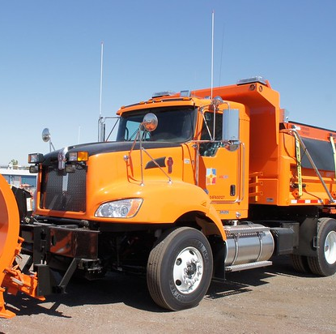
Road Equipment Capital Fund
track skid steer loader and a skid steer bucket, a sweepster broom and a tilt coupler as accessories
an excavator
2021 Estimated Net Fund Balance - $691,000
Notes:
$200K IN TOTAL EXPENSES

Slide 30
Recreation Operating Fund
Key Revenues
Key Expenditures
$134,000 in Real Estate Taxes
$69,000 in Charges for Services
Personnel
$71,000 in Maintenance
$65,000 in Recreation Activities
$25,000 Interfund Transfer to RCRF
2021 Estimated Net Fund Balance - $204,000
Notes:
The Recreation Fund is the operating budget for recreation programs and services, including overseeing 302 acres of park land and open space, numerous buildings and other recreation amenities. A dedicated tax levy of .180 mills will generate $134,500.
The Fund has two main sections: Recreation Administration and Participant Recreation. Recreation Administration accounts for general costs associated with the overall management of the department. Recreation Administration costs are budgeted at $55,250 in 2021. Participant Recreation includes the cost for summer camp operations, instructor fees, ticket purchases, and other program related expenses. Program fees and charges fund the cost of participant recreation services. Participant recreation services are budgeted at $65,325 in 2021. The cost for these services is consistent from year to year and varies based on program participation.

Slide 31
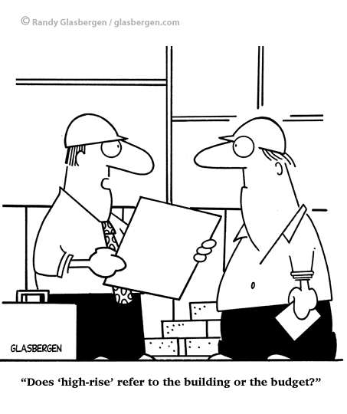
Capital Reserve Fund
funds for our Administration and Police Department Renovation Project
engineering, permitting and hard costs related to a new structure to hold salt
hard costs to replace the roof and side doors on a storage shed
a storage shed to house storage currently at the Recreation Center
improvements to the bridge at Rosenberry Road over West Branch of Swamp Creek
body cameras and two replacement vehicles for the Police Department
2021 Estimated Net Fund Balance - $52,000
Notes:
CLOSE TO $2.5 MILLION IN ANTICIPATED EXPENSES

Slide 32
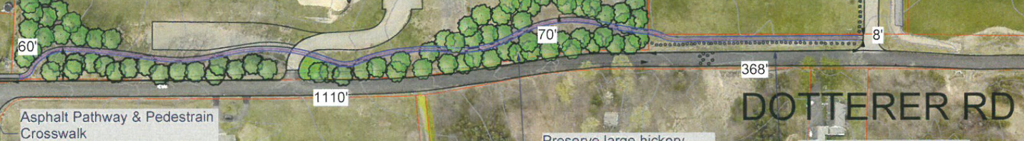
Recreation Capital Reserve Fund
a new filter for the pool and replacement concrete pads on the pool deck at Hickory Park
a storage shed to house storage currently at the Recreation Center
installation of a trail along Dotterer Road near Windlestrae Park, pending grant approval
2021 Estimated Net Fund Balance - $177,000
Notes:
$29K IN TOTAL EXPENSES

Slide 33
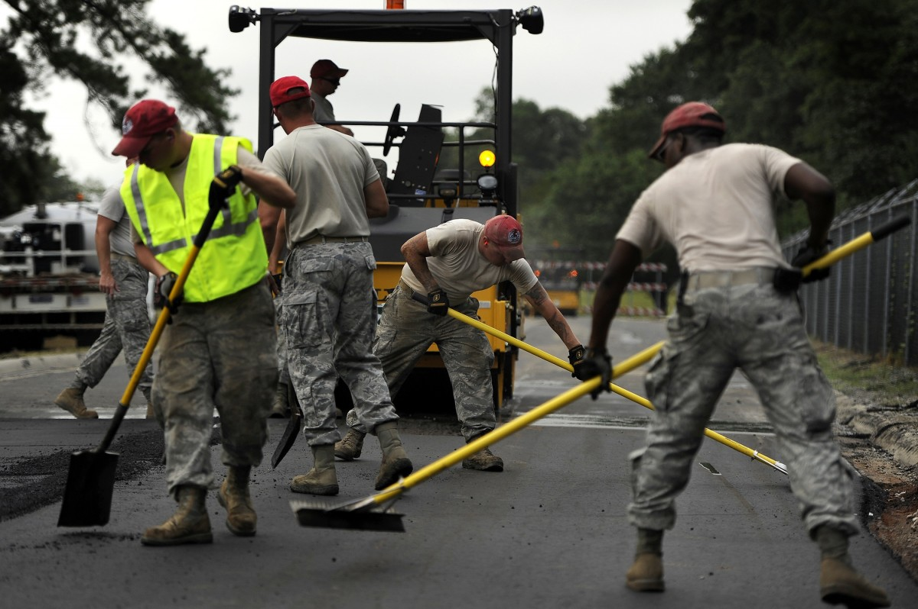
Liquid Fuels Fund
The Township will resurface or treat 8.99 miles of Township roads.
2021 Estimated Net Fund Balance
$ (72,411)
This Photo by Unknown Author is licensed under CC BY-NC-ND
Notes:
State Shared Revenue = $443k
We will need to consider cutting projects if estimated bids do not come in lower than budgeted.

Slide 34
Notes:
The Township has at least 80 miles of road to maintain in its system. The general rule of thumb is a road should last at least 20 years; thus the Township should be treating at least 4 miles of road annually. Total projected revenue in 2021 is $445,000 and appropriations are $785,000.

Slide 35

Future Trends and Outlook
This will be the 15th year in a row that taxes will not be raised (while reducing them in 2019).
GFOA recommends a municipality to have between 8% and 12% in fund balance reserves. At the end of 2020, the General Fund will have approximately 57% in fund balance reserves.
The Township will realize an increase in its financial stability for at least a few more years as current development is built out and new development is considered.
The Township is positioned to strategically plan future budgets and adjust appropriations to match available resources.
Notes:
Government Finance Officers Association

